Slide 1
Difference between Dynamic Programming and Greedy Method
Both methods are used for solving optimization problems.
Both are different strategies but the purpose is same.
Optimization problems are those which requires either
minimum result or maximum result.
Both methods are different.
In greedy method we try to follow predefined procedure to get optimal result.
The procedure is known to be optimal. we follow the procedure to get best result like Kruskal method for

Slide 2
finding method for finding minimum cost spanning
Tree.
It always select a minimum cost edge and that gives us best result or
Dijkstra shortest path algorithm always select our shortest path vertex and continue relaxing the vertices so you
get a shortest path, so there is a predefined procedure.
However, In dynamic programming we'll try to find out all
possible solutions and then pick up the best solution- the
optimal solution.

Slide 3
  DP approach is different and it is little time consuming compared to greedy method.
  For any problem, there may be many solutions which are feasible so we'll try out all those solutions and then pick up the best one.
  Mostly dynamic programming problems are solved by using the recursive formulas.
  We will not use a recursion of programming but
  the formulas are recursive if we want, we can use recursion also but mostly they are solved using iteration

Slide 4
Dynamic programming follows principle of optimality which says that a problem can be solved by taking sequence of decisions to get the optimal solution
so now I can highlight one difference: in greedy method decision is taken one time that we will do it like this and we follow that procedure.
In dynamic programming, at every stage we take a decision
let us see how dynamic programming adopts tabulation method or
Memoization.

Slide 5
Dynamic Programming
DP solves problem by combining the solution to sub-problems.
DP applies when sub problems overalp
DP algorithm solves each sub-problem just once and then saves its answer in table, so that it can used in future.
DP is mainly applied to optimization problems
Optimization means each solution has a value and we wish to find a value with minimum and maximum value.
DP usually uses a reucrsive method/formula or follows principle of optimality i.e. problem can be taking decisions at each stage.

Slide 6
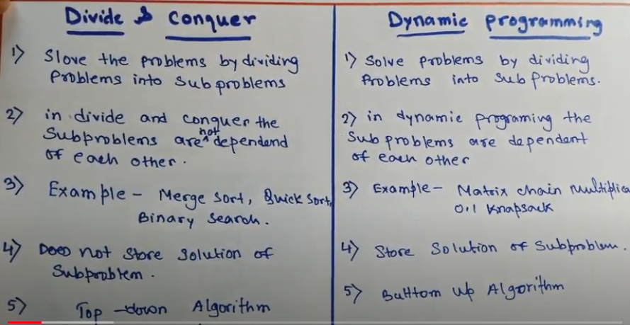


Slide 7
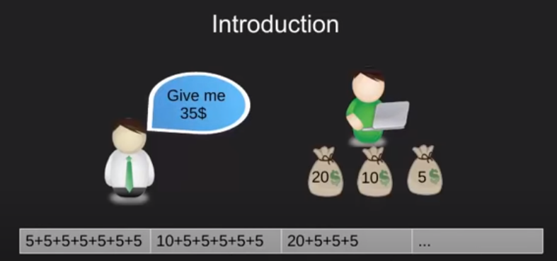
Notes:
He ask for 35$ but in minimum number of coins.

Slide 8
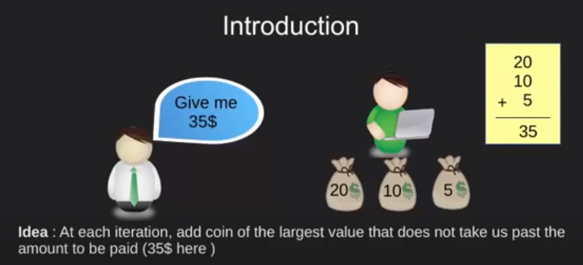
Notes:
Thinking for a while- proposes a solution—greedy idea. Here the thing to note is that after every iteration he is making a choice,
one which is greedy in nature giving the coin with largest value possible.

Slide 9
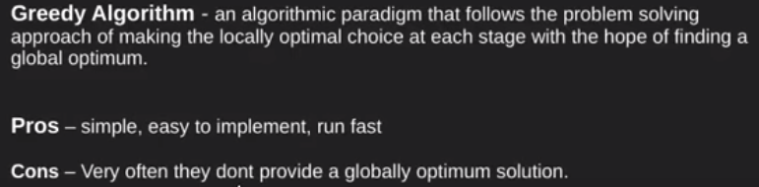
Notes:
At each stage, we select local optimal values with the hope of getting best possible solution.
Easy to code and reasonable time complexity. However the main drawback for this method is ,that there are very few cases wherein
we end up getting the globally optimal value.

Slide 10
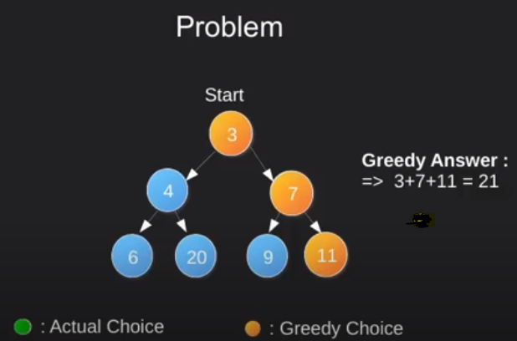
Notes:
With this example we'll see how the algorithm makes locally optimal choices however ending up at a non optimal solution.
So in this tree we are required to get the largest root to leaf sum. Find a path from root to leaf with max sum of nodes.
Greedy choice at each stage: select the largest node.

Slide 11
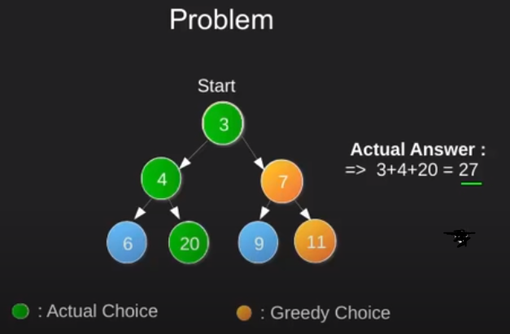
Can we do better than this
Notes:
If we start from 3, go to 4 and then to 20, this path would give us a sum of 27 which is greater than the one we have achieved through greedy method.
So here we conclude that making locally optimal greedy choices don't always give us a globally optimal value.

Slide 12
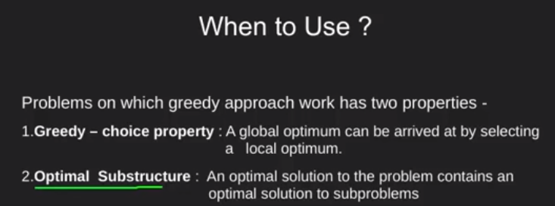
Notes:
So, when are we suppose to use greedy methods ?
All problems which are generally solved using greedy algorithms satisfy two properties.
The greedy-choice property, i.e making the best choice at a moment will lead to a global optimum (best solution)
Next property is the optimal substructure, problems whose optimal solution can be constructed efficiently from optimal solutions of its subproblems
This property may look similar to one in dynamic programming however one thing to note here is that greedy algorithm never reconsider its choices.
This is the main difference from dynamic programming, which is exhaustive and is guaranteed to find a solution.

Slide 13
